Slide 1
SmartVision AI
Intelligent Multi-Class Object Recognition System
End-to-End Deep Learning Solution

Slide 2
Identifying the Recognition Gap
Organizations across industries face a critical need for intelligent systems that can accurately navigate real-world
visual complexity.
The Challenge
Multi-category object identification
Handling diverse lighting/angles
Low-latency real-time inference
Scalability for cloud deployment
Manual image annotation is slow, error-prone, and impossible to scale for high-volume surveillance or retail environments.

Slide 3
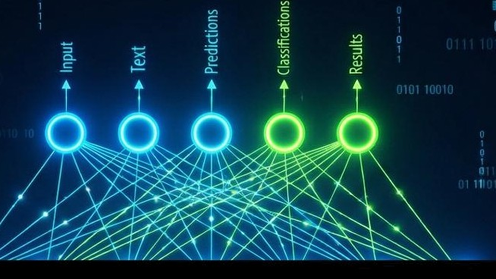
Integrated AI Vision Solution
Bridging classification & Detection
Our platform combines state-of-the-art CNNs with YOLOv8 to provide a comprehensive recognition pipeline.
Image Classification: Identifying individual objects using Transfer Learning.
Object Detection: Simultaneous localization of multiple objects in one frame.

Slide 4
Targeted Dataset Characteristics
2,500 Images
25 Classes
Equal Split
A curated subset of the
Diverse categories including
Exactly 100 images per class
industry-standard COCO
vehicles, animals, people, and
ensures no bias toward
dataset for balanced training.
indoor items.
dominant categories.

Slide 5


Advanced Technology Stack
Python
Deep
Front-End
Cloud
Learning
Core development &
Streamlit Dashboard
Hugging Face
Logic
PyTorch / YOLOv8
Spaces

Slide 6

Transfer Learning Implementation
Classification Base
We leverage 4 foundational architectures to compare feature extraction quality:
VGG16: Depth-focused features.
ResNet50: Residual connection efficiency.
MobileNetV2: Optimized for speed.
EfficientNetBO: Advanced scaling logic.

Slide 7
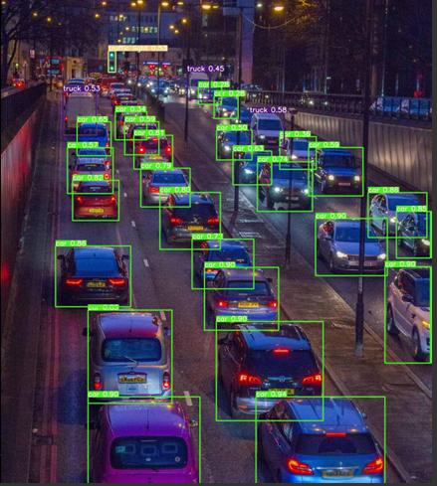
Precision YOLOv8
Detection
Detection goes beyond "what" is in an image to exactly "where" it is located.
Yolov8 provides multi-object localization with high mAP scored and bounding box coordinated in real-time.
Ideal for traffic management and high-density urban
surveillance.

Slide 8
Benchmarking Model Accuracy
EfficientNetB0 achieved fee highest va//dation accuracy while maintaining a 6a/anced computational footprint.

Slide 9
Core Application Feature Matrix
Feature
Implementation Detail
User Benefit
Multi-Model Prediction
Comparison of 4 CNN architectures
Confidence validation across models
Live Detection
Webcam stream integration
Real-time security monitoring
Optimized Inference
Weight Quantization
Faster response times in cloud
Interactive EDA
Visualization dashboard
Transparency in training data

Slide 10
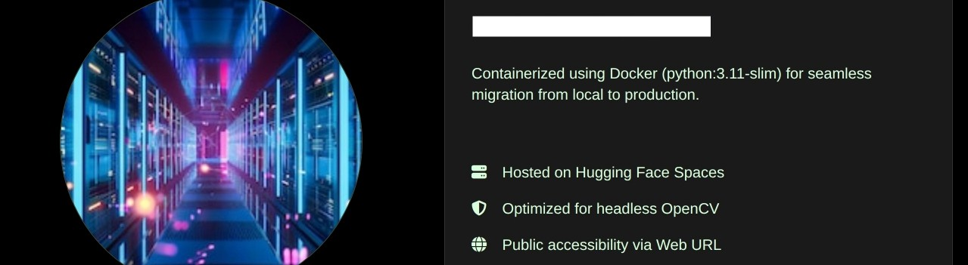
Scalable Cloud Architecture
P
Production Deployment

Slide 11
Thank You

